Slide 1

Project Presentation
SEED SOWING ROBOT
Group No:
Project Supervisor
Dr. Gayatri Sakya
Group Members
1. Kritika Gupta (1809131087)
2. Kumar Lakshya (1809131090)
3. Manaswini Sinha (1809131094)
DEPARTMENT OF ELECTRONICS AND COMMUNICATION ENGINEERING

Slide 2
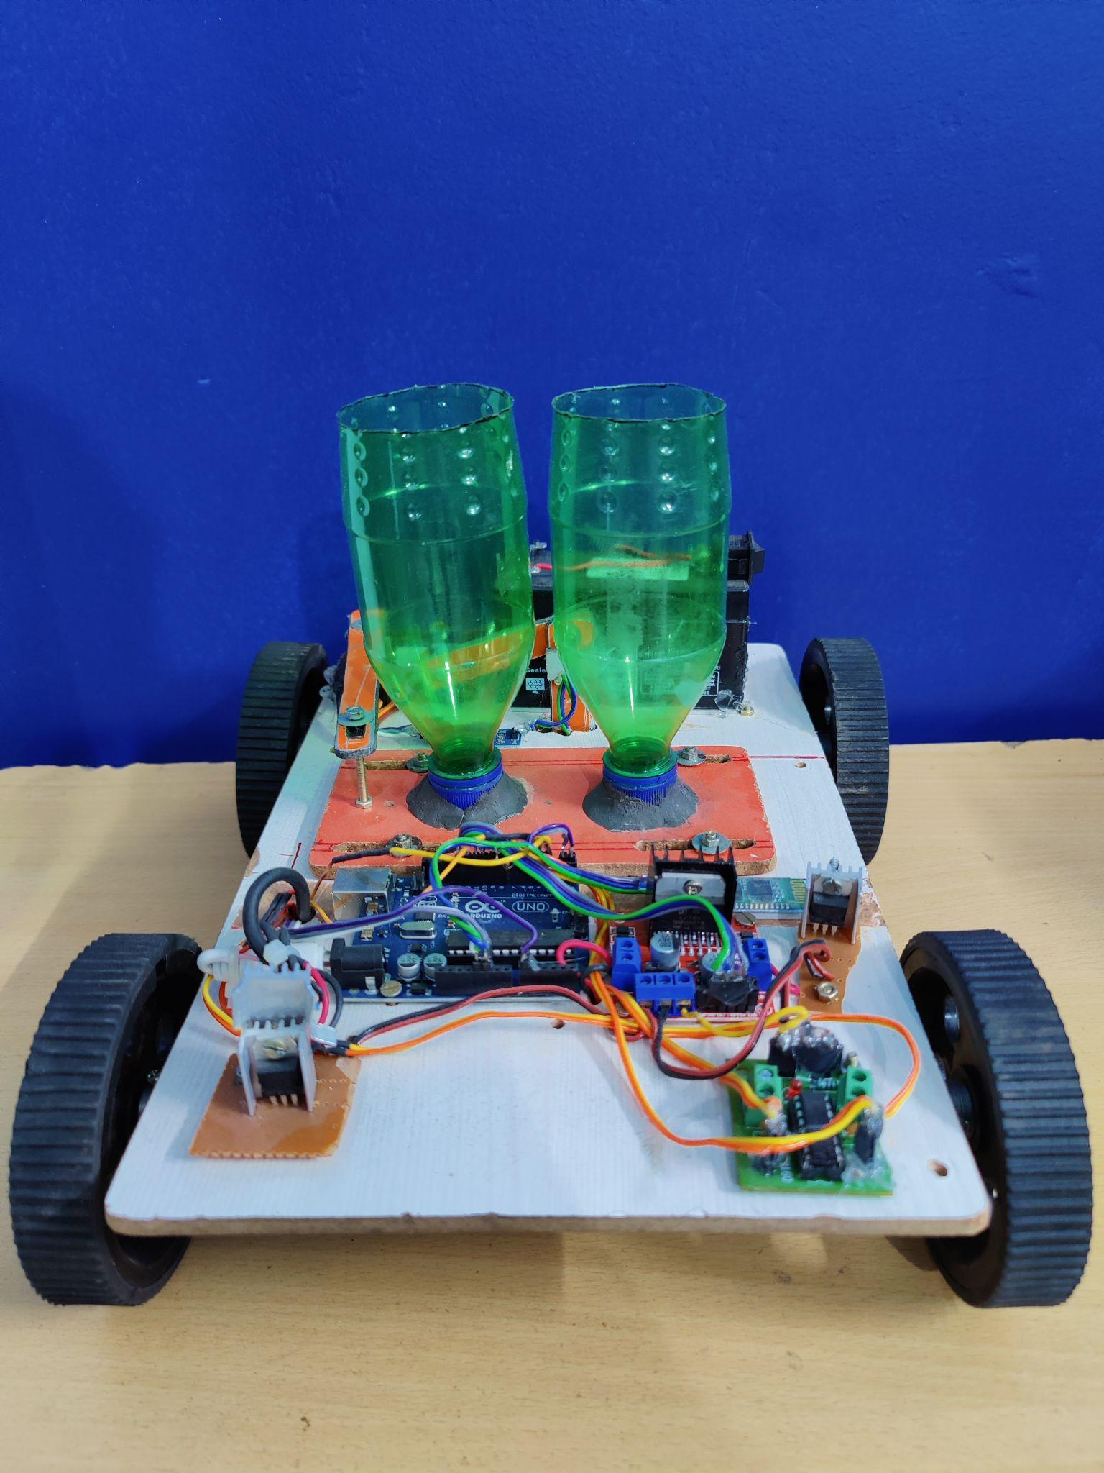
Problem statement
Design and development of a seed sowing robot.

Slide 3
Objectives
Design and development of a seed sowing bot for-
Automated seed sowing with efficiency and accuracy.
To check moisture level of soil.
To remove weeds using weed cutter.
Seeds sown at a particular distance.
Availability of two modes i.e. Manual and automatic modes

Slide 4
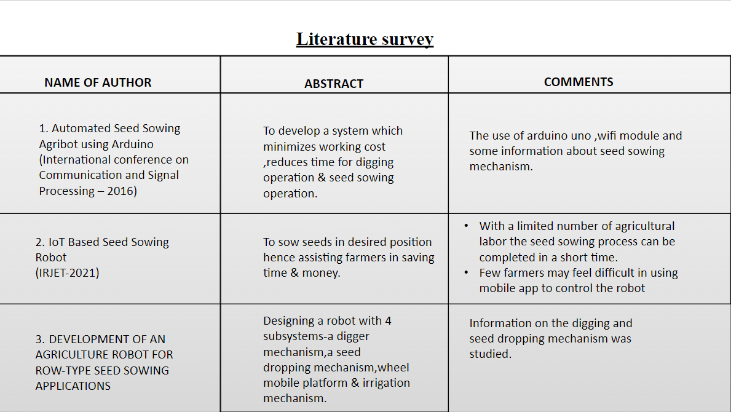

Slide 5
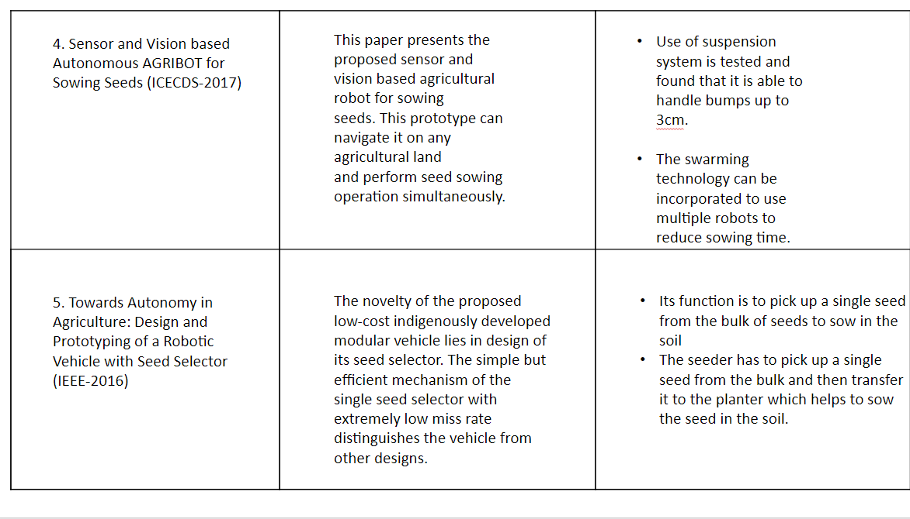

Slide 6
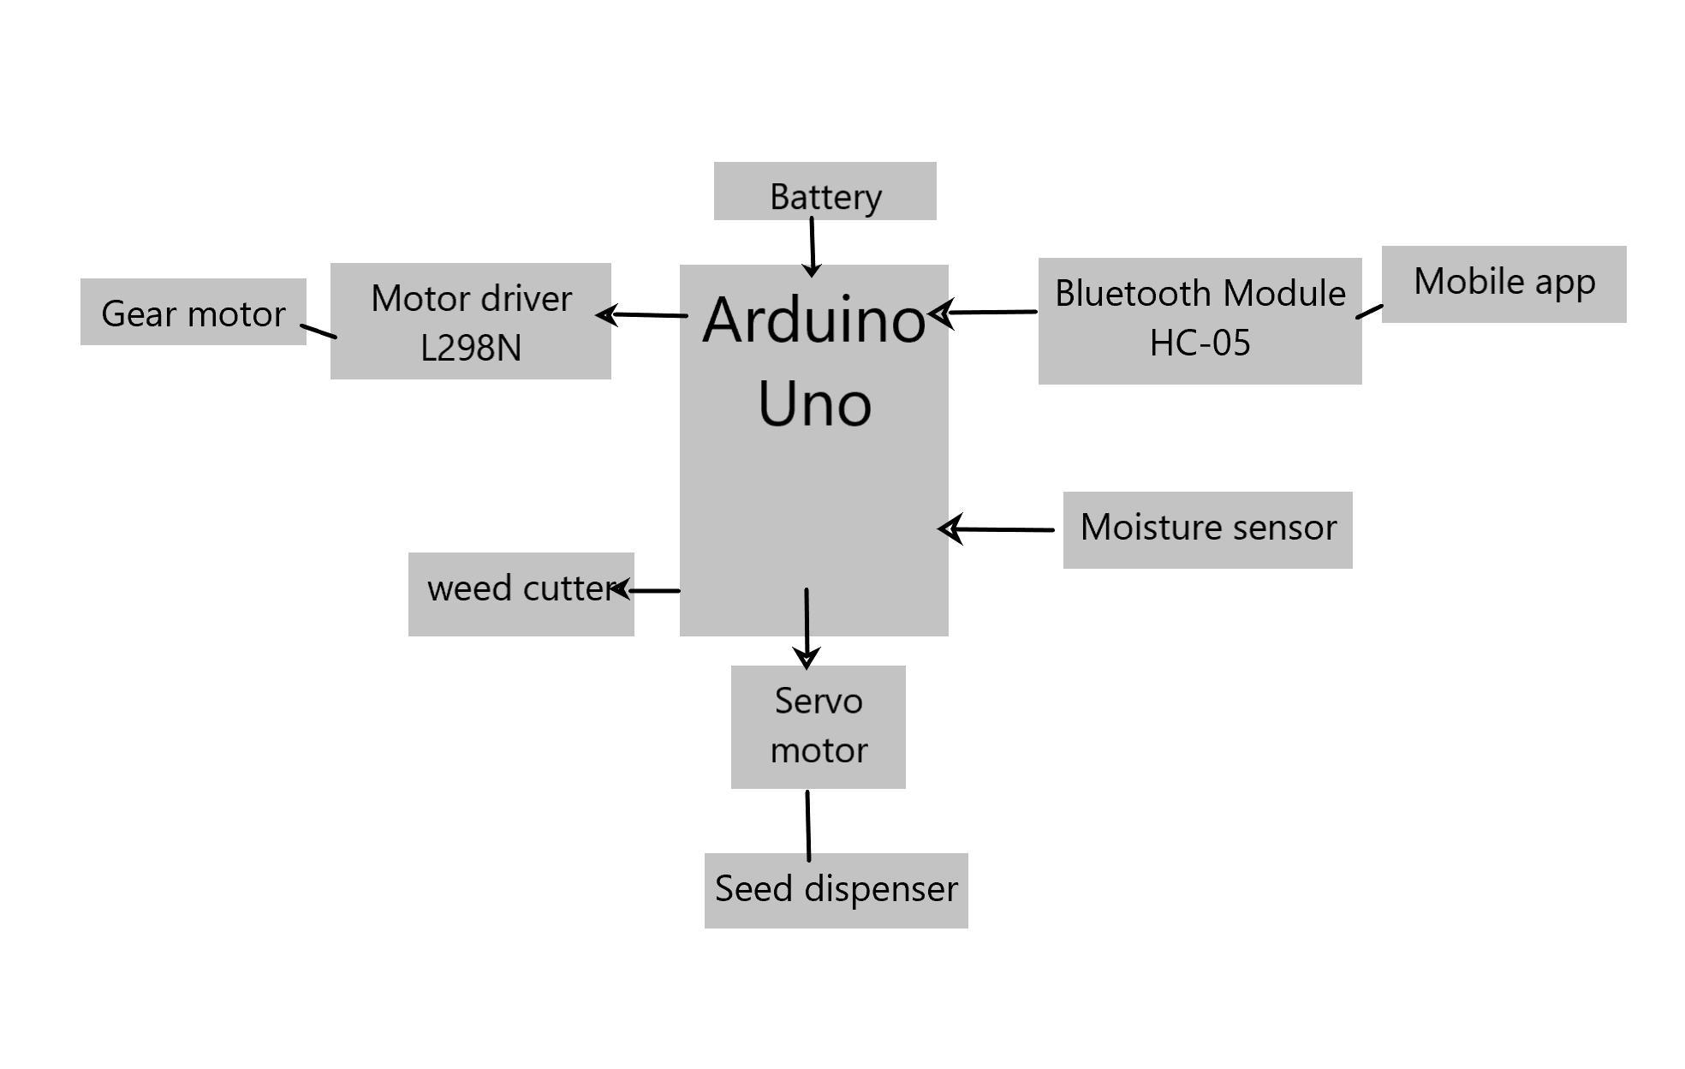
Block Diagram

Slide 7
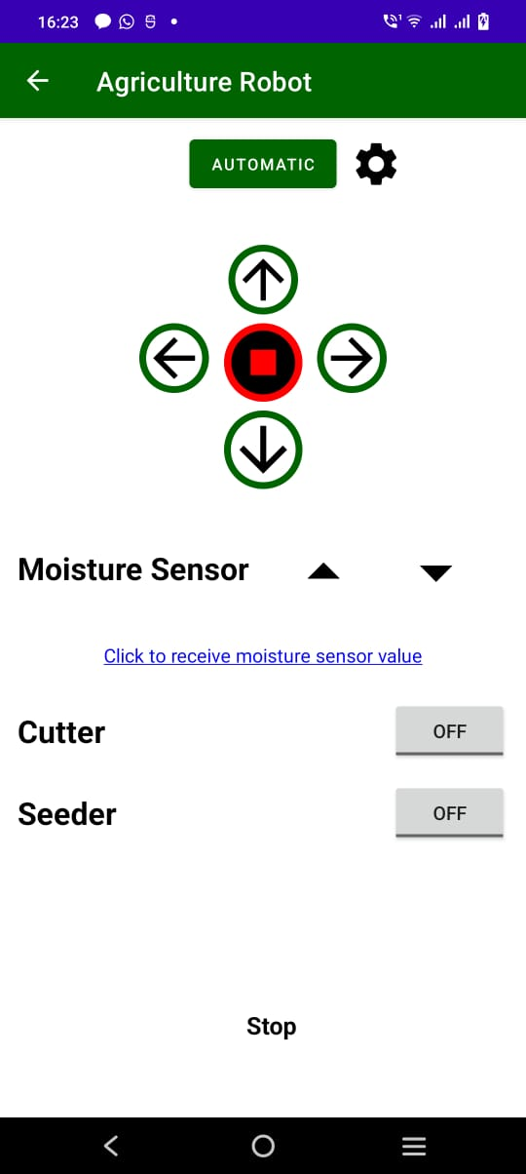
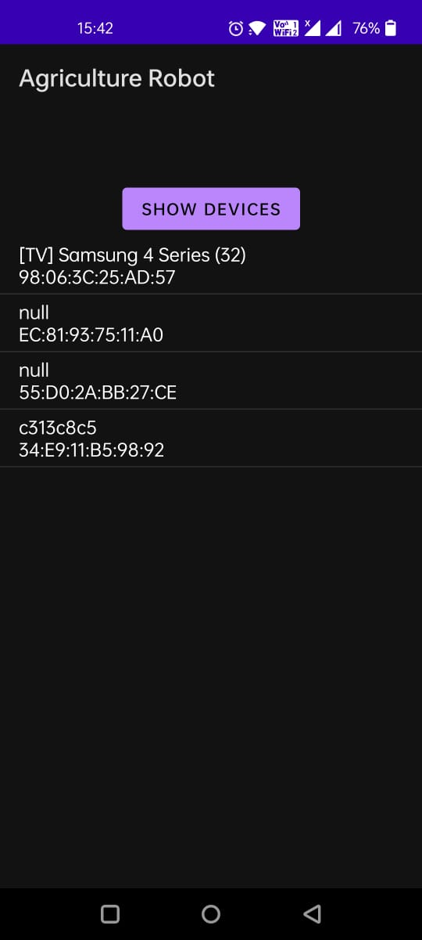
Methodology
Our system is a four-tyre vehicle which is driven by geared DC motor
It establishes communication between farmer and AgriBot via Android App for starting the robot.
It helps to control weed with the help of cutter.
There’s a moisture sensor which will tell when the soil needs water by sensing the moisture content and sending the data on the app.
The robot is connected to the mobile via bluetooth to the app “agriculture robot”.Once the device is visible in the app it is connected through which we can now control the movement of robot,seed funnel and the weed cutter as well.
Functions being shown on the app
Agriculture robot app

Slide 8
Components
S.no | Hardware components
1 | Arduino Uno
2 | Soil moisture sensor(YL 69)
3 | Bluetooth module HC-05
4 | Motor driver L298D
5 | DC gear motor
6 | Motor driver L293D
7 | Voltage regulator 7805
8 | Heatsink
9 | Battery
10 | Robot chasis
11 | Seeds container
12 | Cutter
13 | Mechanical wheels

Slide 9
Result with validation
Replacing human labour with automation is a growing trend across multiple industries, and agriculture is no exception. Most aspects of farming are exceptionally labour-intensive, with much of that labour comprised of repetitive and standardized tasks—an ideal niche for robotics and automation.
Advantages
1. Labour can be eliminated as most of the works are done by agricultural robots. Weeding is one of the the main work related to the farm which needs manpower and the robots can handle all these. One agricultural robot can handle the work of approximately 10 workers.
2. Through the introduction of agricultural robots, farmers will feel self-employed as their dependency on labour decreases. The investment can be done once and the profits would be huge as the operating costs decrease.
3. There will be a drastic increase in the production of crops
4. Adjustable seeding rate.
5. It is compact in size.
Disadvantages
1. Implementation of robotics in agriculture is very costly.
2. The complexity of the farm increases and there is an equal risk if proper care is not taken.
3. The labour employed to take care of the farm should be well skilled in technology.

Slide 10
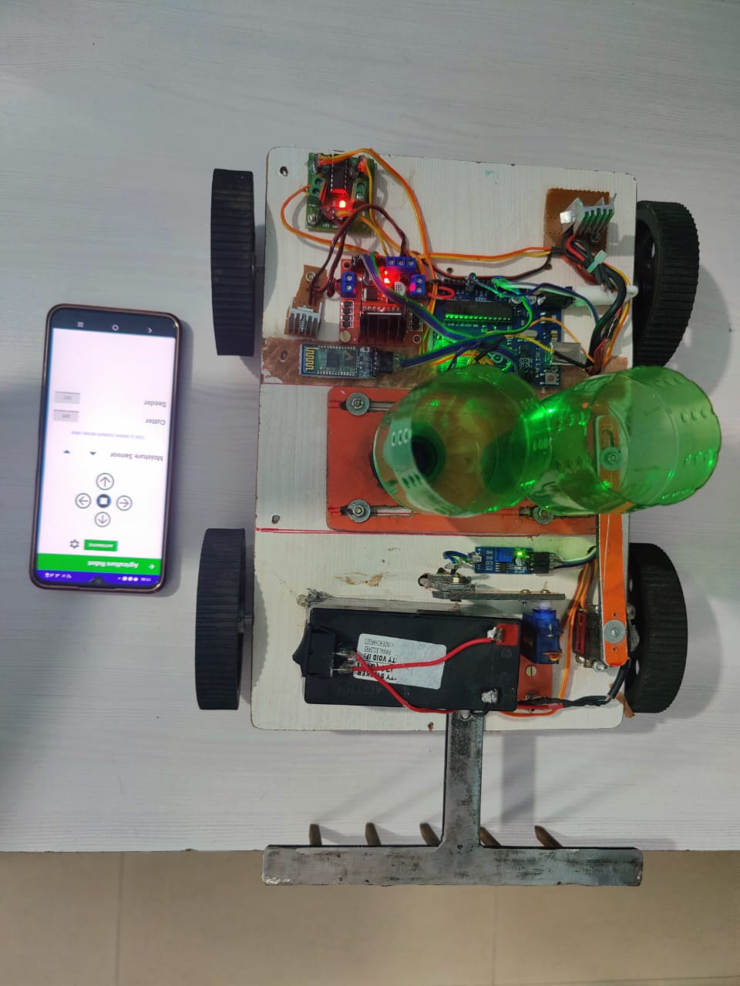
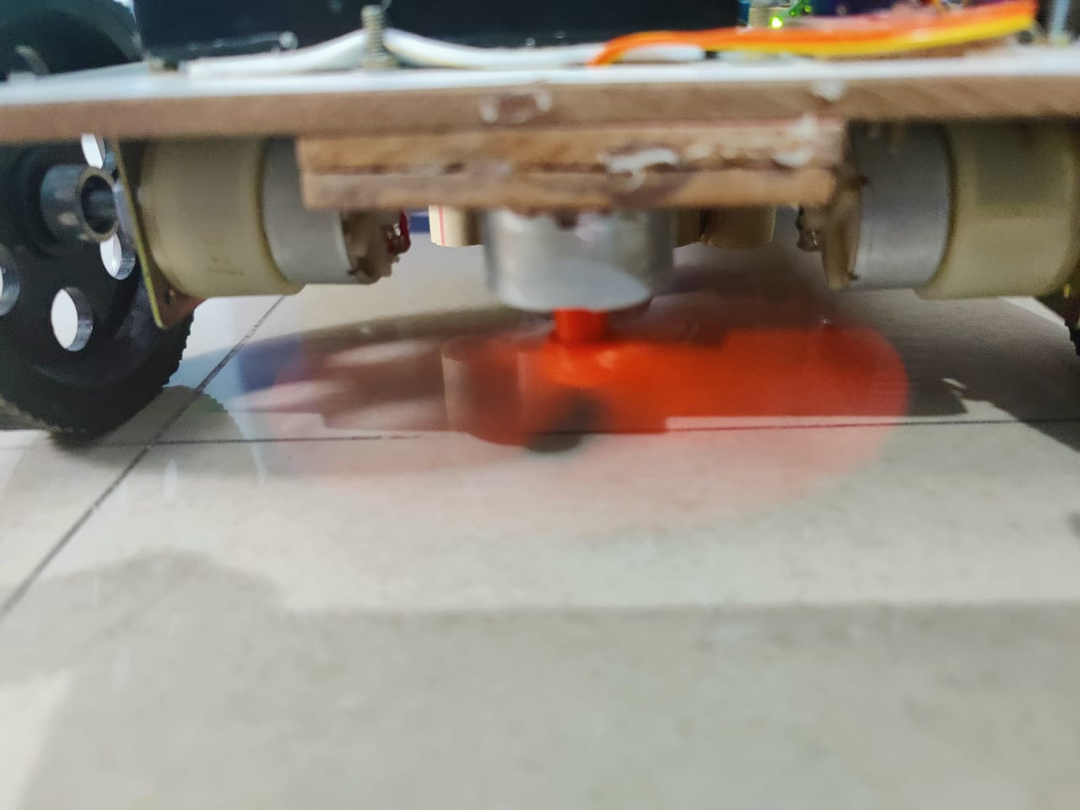
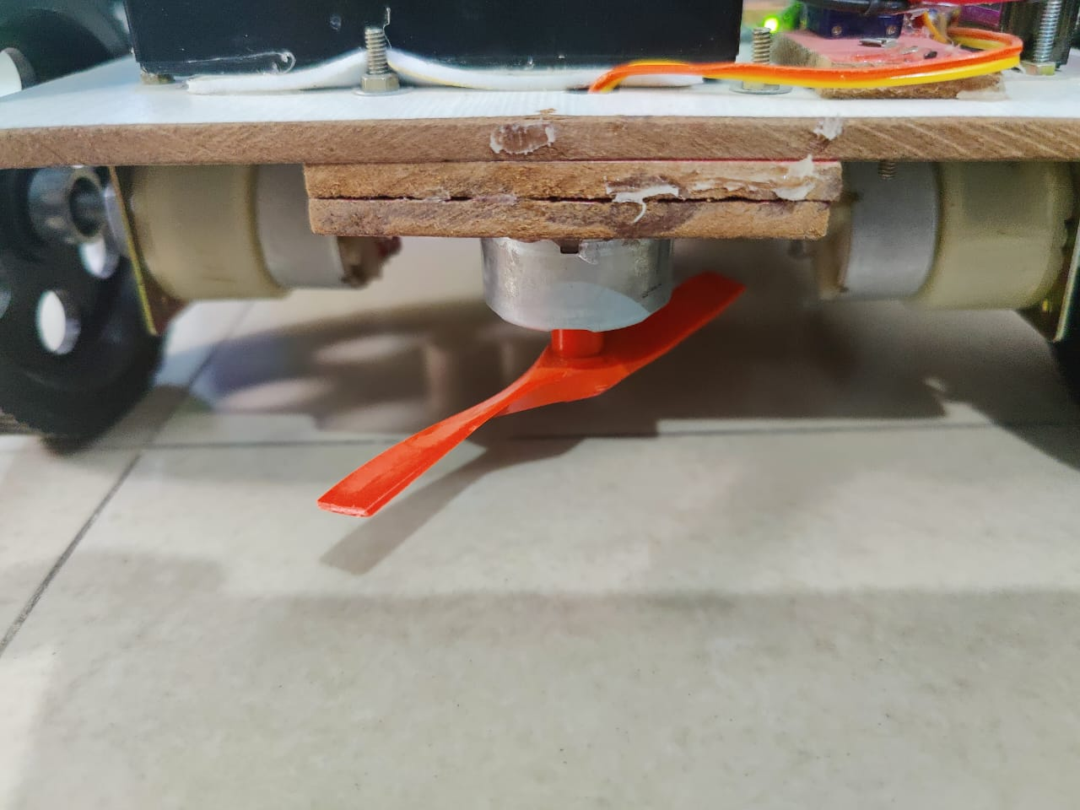
Conclusion
This system is cheaper and efficient when compared to other type of automation system. In large scale applications, high sensitivity sensors can be implemented for large areas of agricultural lands.
Thereby reducing the stress on farmers.
Weed cutter operating
Weed cutter
Seed sowing robot

Slide 11
REFERENCES
Sweety Dutta, Udit Shanker, Sulekha Katiyar, Venktesh Singh, Mohd. Nayab Zafar, J. C. Mohanta, “Development and Fabrication of an Autonomous Seed Sowing Robot”, ICCEMME-2019
Cihan YURTSEVER, Yasin ERTAS , Oben SUSTAM , Cenk ULU, “DEVELOPMENT OF AN AGRICULTURE ROBOT FOR ROW-TYPE SEED SOWING APPLICATIONS”, Journal of Selcuk-Technic Special Issue 2020 (ICAT’20)
Masood Ul Hassan, Mukhtar Ullah, Jamshed Iqbal. “Towards Autonomy in Agriculture: Design and Prototyping of a Robotic Vehicle with Seed Selector”, IEEE-2016
P. Vidushini, Sorna Abishek M, Sooriya Kumar Ar, D. Venkata Nithish Reddy. “IoT Based Seed Sowing Robot”, International Research Journal of Engineering and Technology (IRJET), Volume: 08 Issue: 03 | Mar 2021
Palepu V. Santhi, Nellore Kapileswar , Vijay K. R. Chenchela, Venkata Siva Prasad. CH 2.” Sensor and Vision based Autonomous AGRIBOT for Sowing Seeds”, International Conference on Energy, Communication, Data Analytics and Soft Computing (ICECDS-2017)
Saurabh Umarkar and Anil Karwankar. “Automated Seed Sowing Agribot using Arduino”, International Conference on Communication and Signal Processing, April 6-8, 2016
Gayatri Sakya , Ankit Gautam. “ Smart Agriculture System using Adhoc Networking among Firebird V Bots”, International Journal of Innovations & Advancement in Computer Science IJIACS ISSN 2347 – 8616 Volume 5, Issue 10 October 2016

